Slide 1
Inexpensive Geophysical Instruments for Groundwater Exploration in Developing Nations Jim Clark Rick Page Department of Geology and Environmental Sciences Wheaton College Wheaton, Illinois

Slide 2
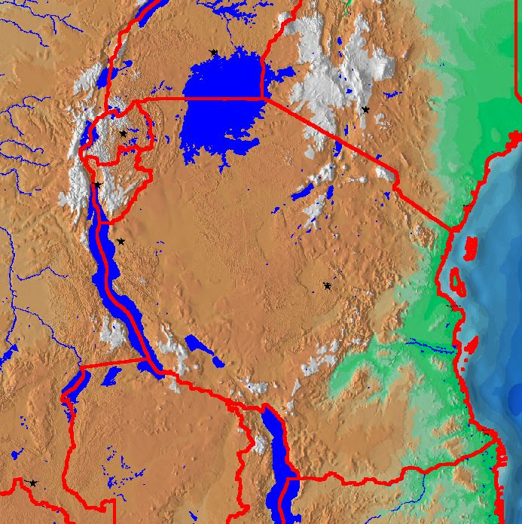
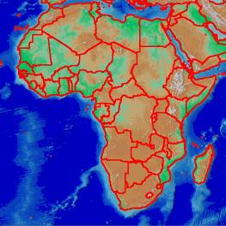
TANZANIA

Slide 3
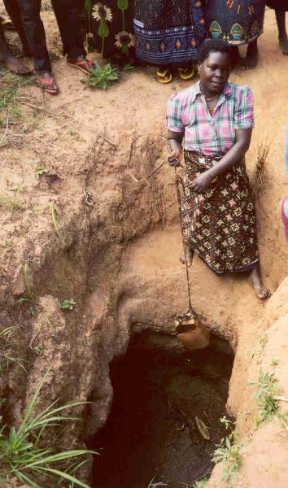
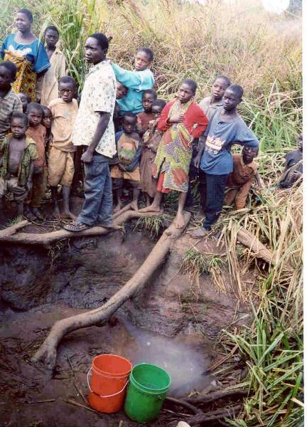
Tanzania village water supplies - Mlafu

Slide 4
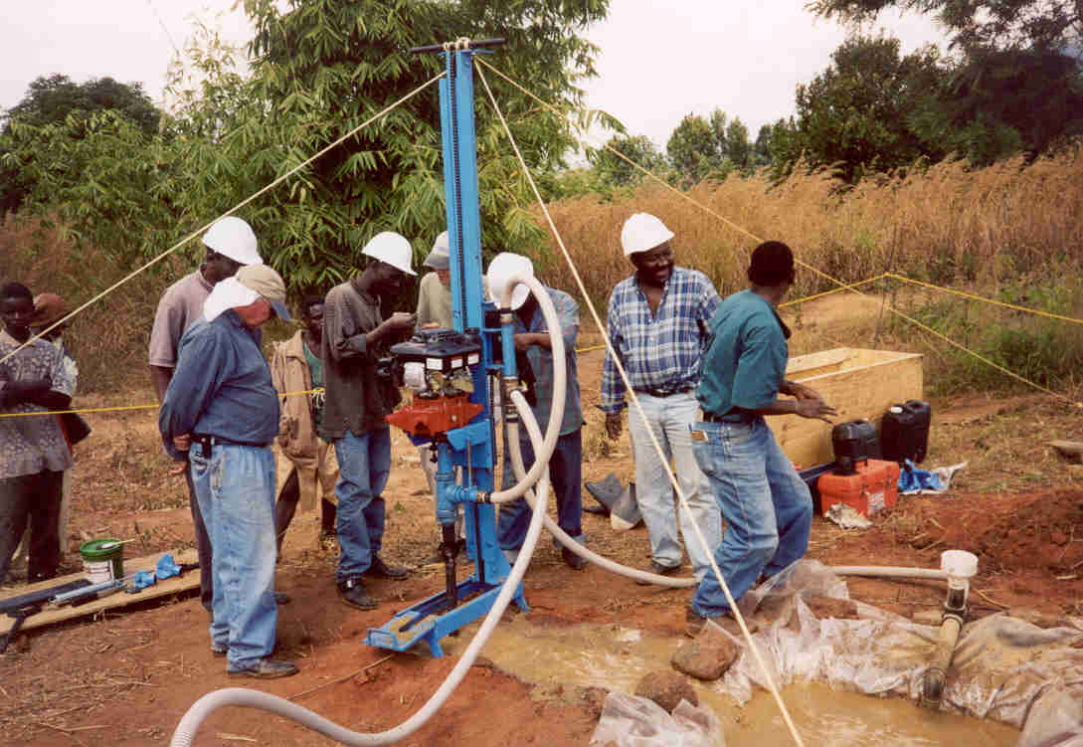
Drilling with the LS-100 mud rotary rig – Training Tanzania drill team Maximum depth 35 m Cannot penetrate bedrock

Slide 5
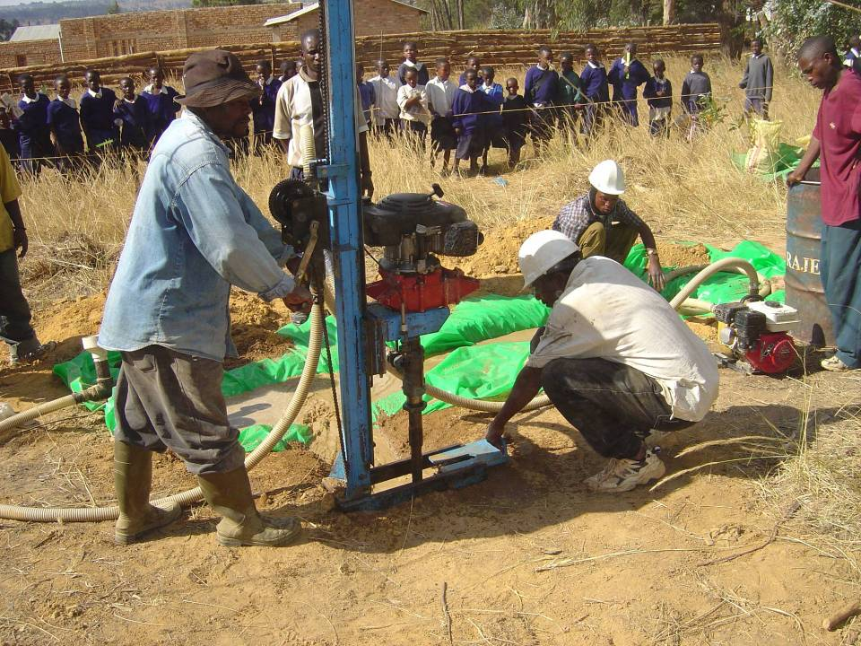

Slide 6
Need for Groundwater Exploration
To support the Tanzanian drilling team
In one year they:
Drilled 50 well holes
Installed 33 hand pumps
Had 17 dry well holes
To give a reason to site the well, apart from offset distances from latrines

Slide 7
Typical Tanzanian Hydrologic Stratigraphy
Quartz Vein
Laterite/Saprolite
Extremely weathered granite/gneiss
Clay rich – Low Permeability
Aquitard
4 – 50 m
Saprock
Slightly weathered granite/gneiss
High permeability - Aquifer
1-2 m
Bedrock – Granite or Gneiss
Low permeability unless fractured

Slide 8
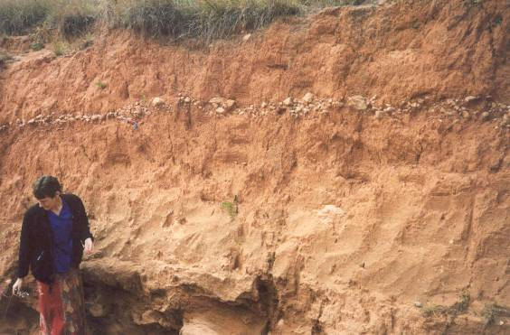
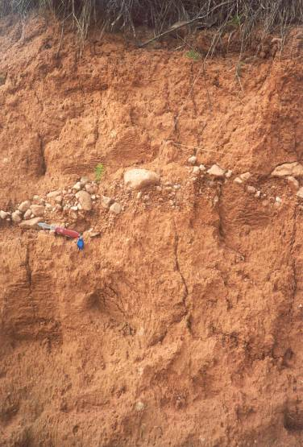
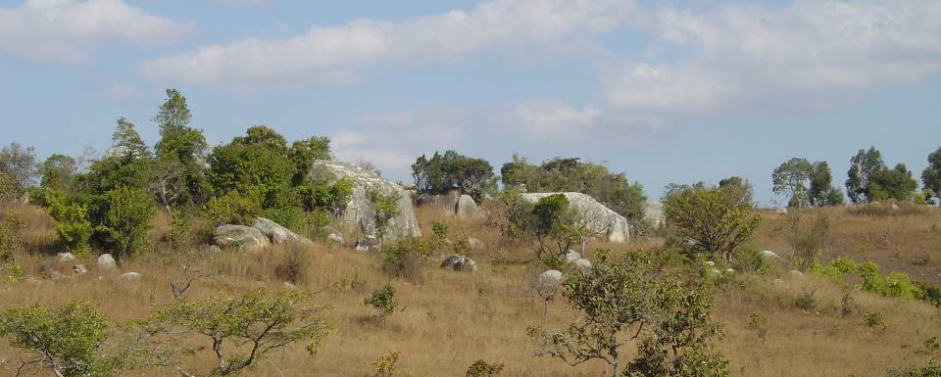

Slide 9
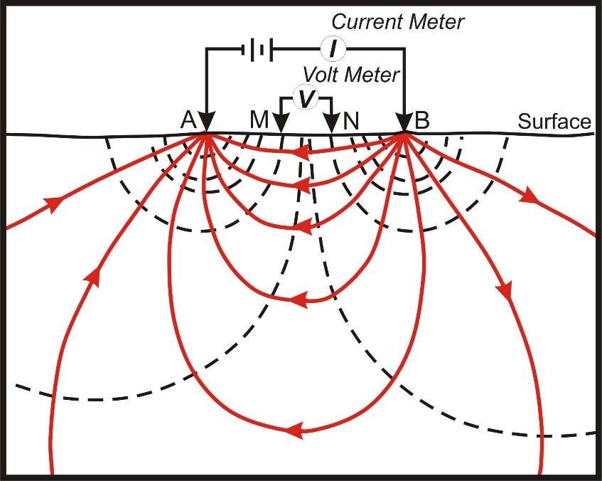
Electrical Resistivity Method
GOAL: To determine depth to bedrock (Saprock aquifer lies just above bedrock)
Depth < 5 m → dries up
Depth > 35 m → exceeds drilling depth
As electrodes spread increases, current penetrates deeper
“Vertical Electrical Sounding” (VES)

Slide 10
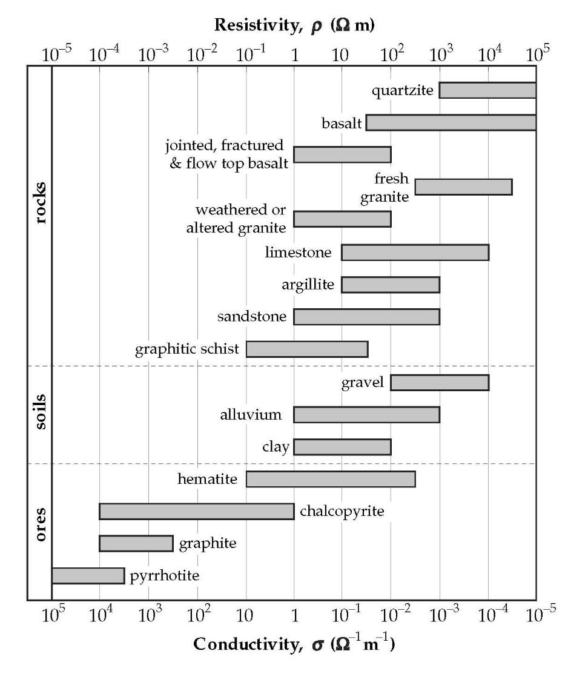

Slide 11
Design Criteria
Inexpensive (< $200)
Easily built from readily available parts
Easily repaired
Robust under field conditions
Easily transported
Battery operated
Easily operated by indigenous well drillers

Slide 12
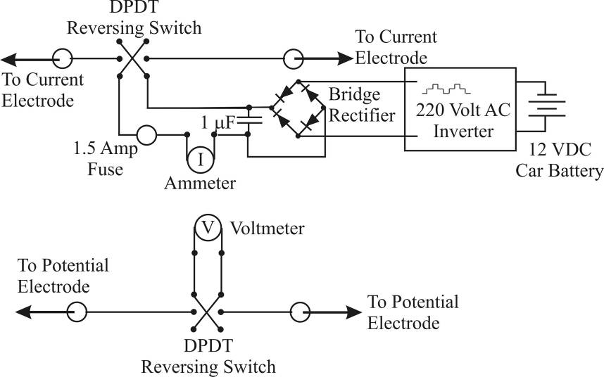
Resistivity Electronics

Slide 13
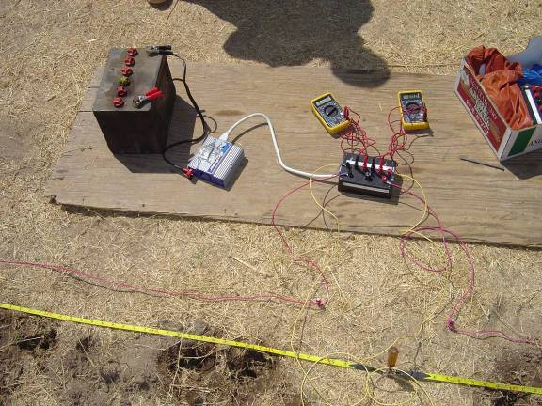
2 Multimeters
(Current & Voltage)
12 Volt DC to 120 Volt AC Inverter
Rectifies AC Voltage to
120 Volt DC
Reverses current to avoid polarization

Slide 14
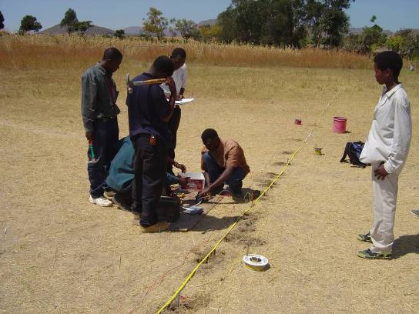
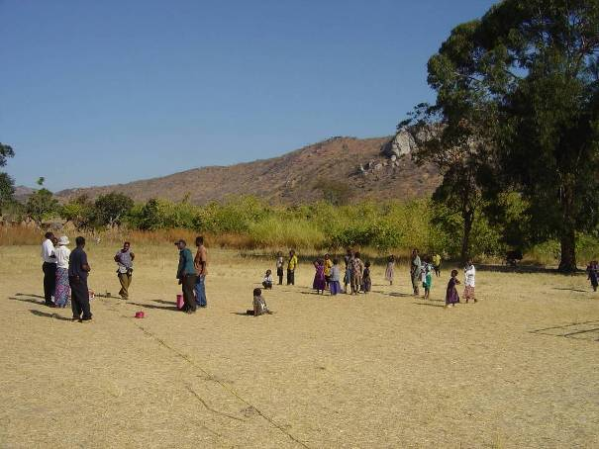
Field Implementation

Slide 15
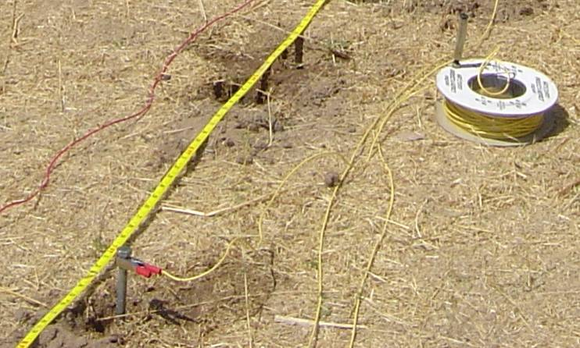
Electrode (a.k.a. a long bolt)
Electrode
Water poured into the ground to increase electrical contact

Slide 16
Comparison of Resistivity Depth Predictions to Observations (meters)
Survey Site | Known Depth to Bedrock | Predicted Depth from Resistivity
Kilimia | 6.1 | 8
Huruma orphanage | 13.7 | about 11
Mafinga | 28.0 | 25
Mgongo | Unknown | 16

Slide 17
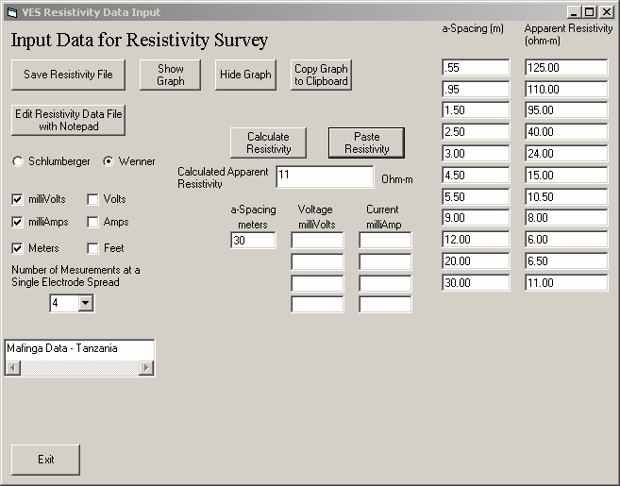
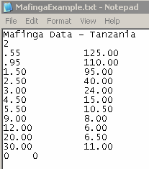

Slide 18
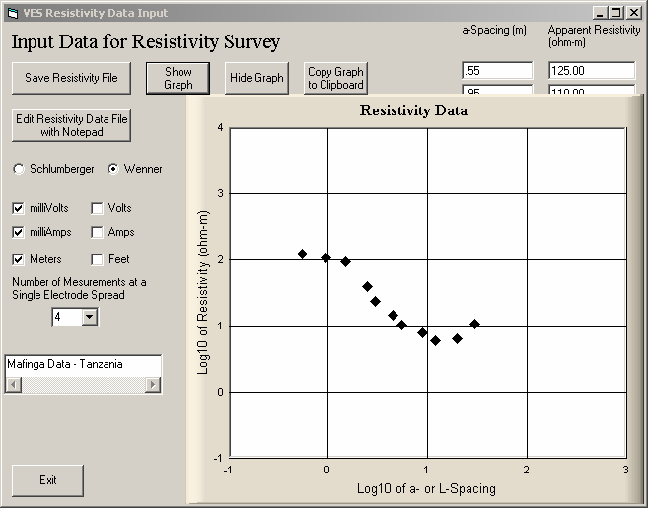
Plot Raw Apparent Resistivity Data

Slide 19
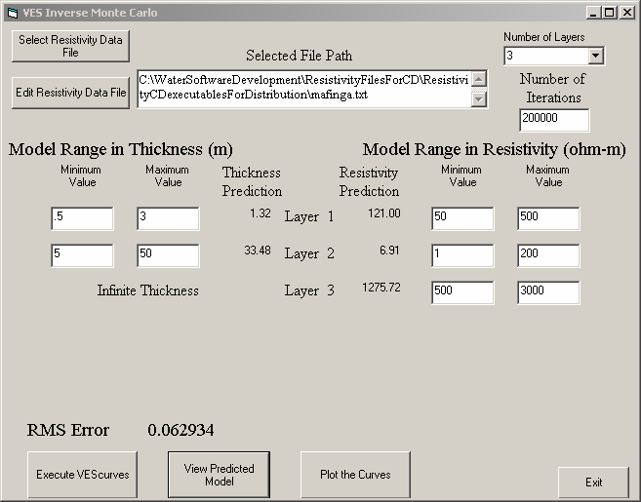
Monte Carlo Inversion
Input Range
Best-Fitting Prediction

Slide 20
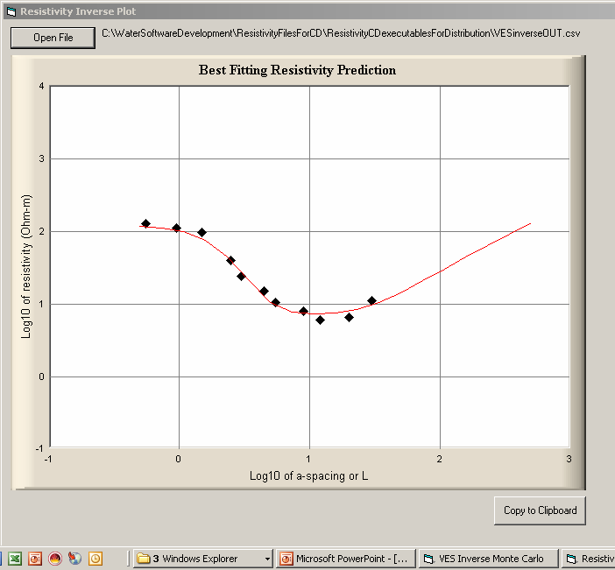

Slide 21
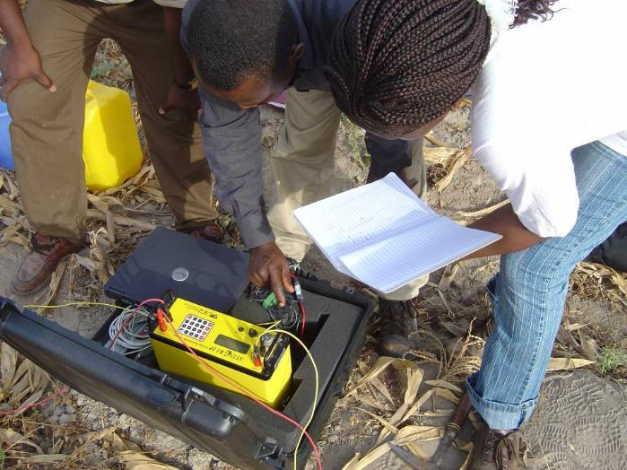
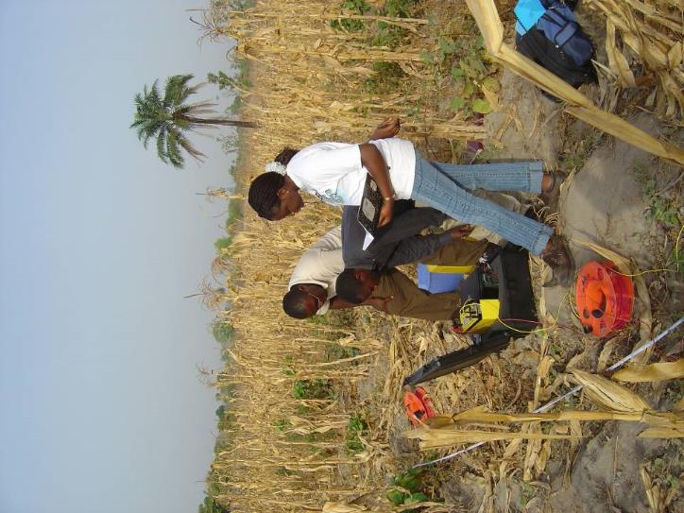
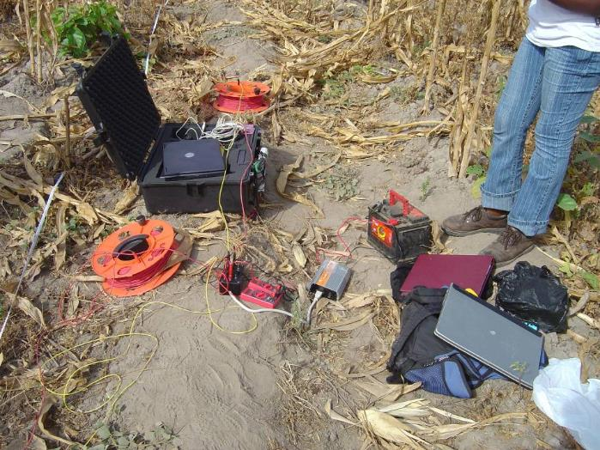
Nigeria
Sting R1 Commercial Resistivity Instrument (used; refurbished; discontinued model; $5000)
vs. Inexpensive Resistivity Instrument

Slide 22
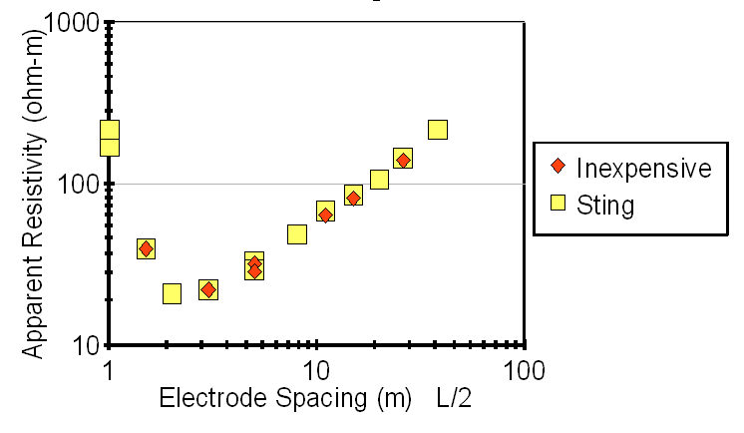
Nigeria Data Comparison: Sting R1 and Inexpensive Instrument

Slide 23
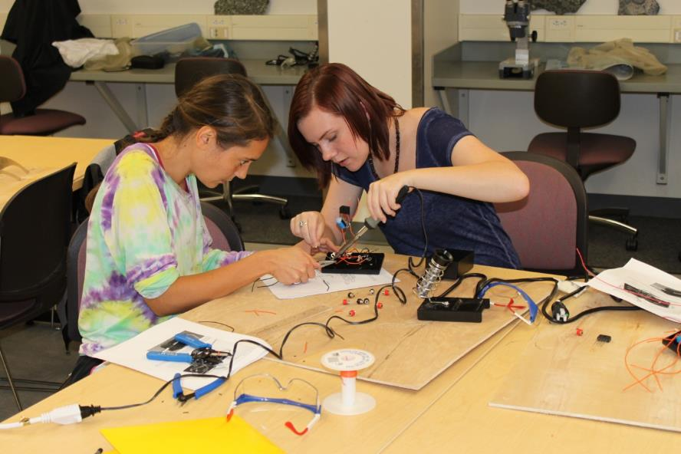
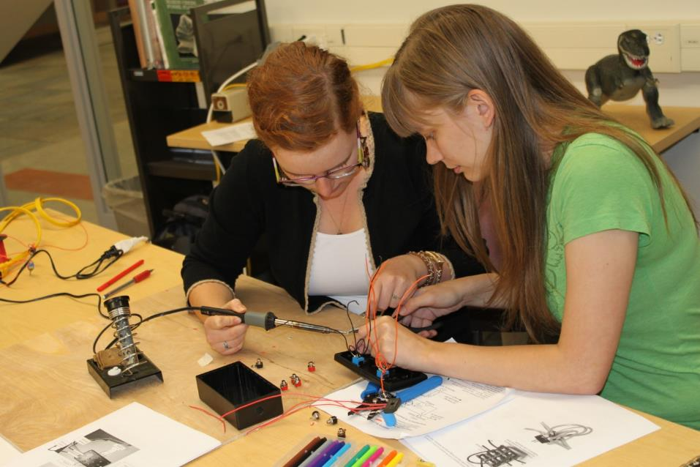
Building the Resistivity Box in Geophysics Lab
Jennifer and Savannah
Kaitlyn and Katherine

Slide 24
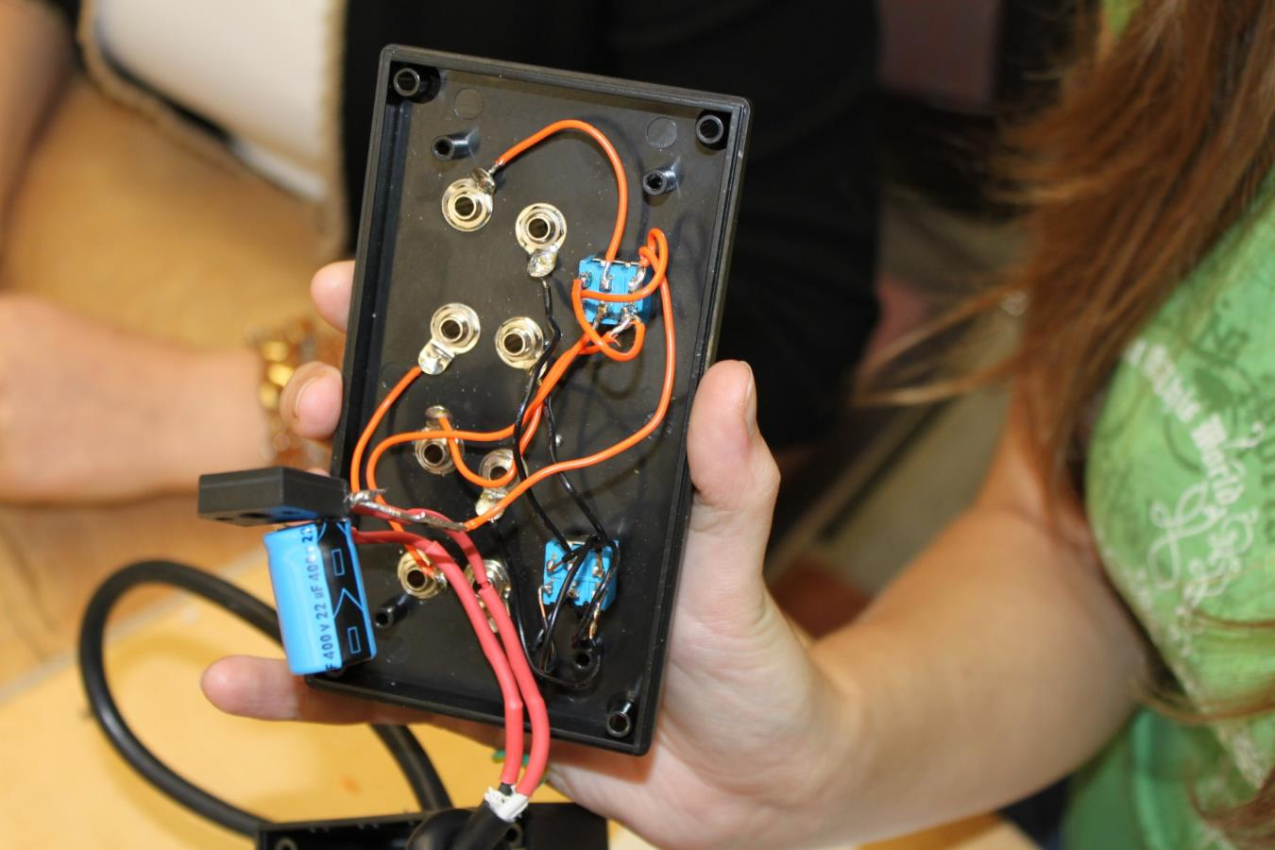
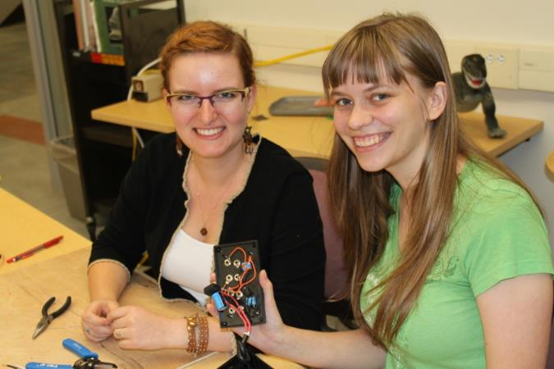
The finished Resistivity Box

Slide 25
Fully functional Resistivity Meter
Microcomputer (Arduino) controlled - $13
Automatic current reversal
Display of average voltage and current values
Possibility of calculating Induced Polarization
Total electronics cost < $60

Slide 26
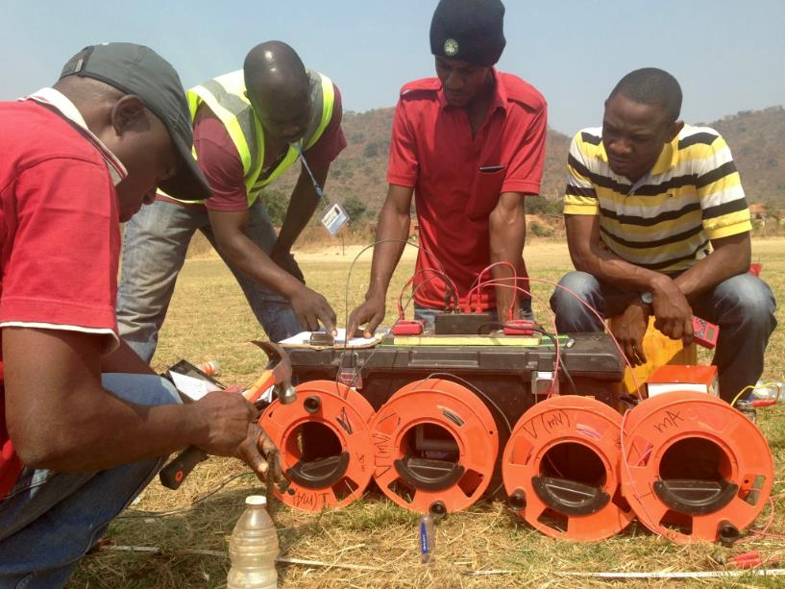
Water4 NGO from Oklahoma
Hand auger water wells in Africa – more than 3000 wells
Trains indigenous drillers
BUT too many dry wells
Wanted geophysics
Inexpensive Equipment
African National Resistivity Teams
Simple training
Easy interpretation
Notes:
The main objective of the study wad to describe and document the experiences of African national teams working with Water.
They are using inexpesnive equipment and are succesfully interpreting resistivity data for improved well sitting success rates.

Slide 27
Many Resistivity Teams use my instrument
Water4 Resistivity teams since 2014:
in 7 countries
22 active VES operators survey before drilling
Trained by Christelle Kwizera - Rwandan
united through WhatsApp
performed 150 site resistivity surveys – 64 are documented in this report
Water4 National Resistivity Teams
Country | Number of Operators
DR Congo | 7
Rwanda | 3
Sierra Leone | 3
Kenya | 3
Uganda | 2
Tanzania | 2
Togo | 2
Notes:
Water4 introduced VES to its Togo teams in 2014.
Since then, the program has now reached 7 countries, and is used in 9 programs.
There 22 active surveyors as in the table.
Of the 150 surveys that were used to sit boreholes as of May 2016, 64 were compounded for this paper.

Slide 28
ANALYSIS
 |  | WELL
 |  | Successful | Not Successful
VES | Positive | 45 Correct Prediction | 2 Incorrect Prediction
 | Negative | 7 Incorrect Prediction | 10 Correct Prediction
Accurate prediction for 55 of 64 wells (86% accurate)
If VES positive then drilling success rate = 96%
Chi-square value of 24.4 with 1 degree of freedom indicates it is highly unlikely that the results in the table are random.
Notes:
We analysed data for 64 wells, of those 64 wells, 45 were predicted as good to drilll. Of the points where VES indicated success, these wells had a 96% success rate.
We did have 7 wells that were predicted as not good to drill, but were drilled at nonetheless, providing a false negative. 10 wells where it was said to not drill, were also bad sites.

Slide 29
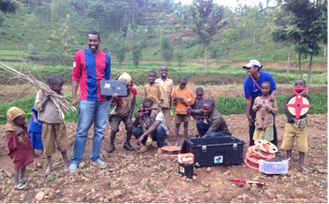
Pygmy Community, Rwanda
$300 resistivity instrument price well below cost of a failed well
Ideal method for site selection of shallow manually drilled wells (<35 m deep)
Skilled African national teams do VES surveys, data interpretation and well siting
Data shared collaboratively among teams (Water4 whatsapp support network)

Slide 30
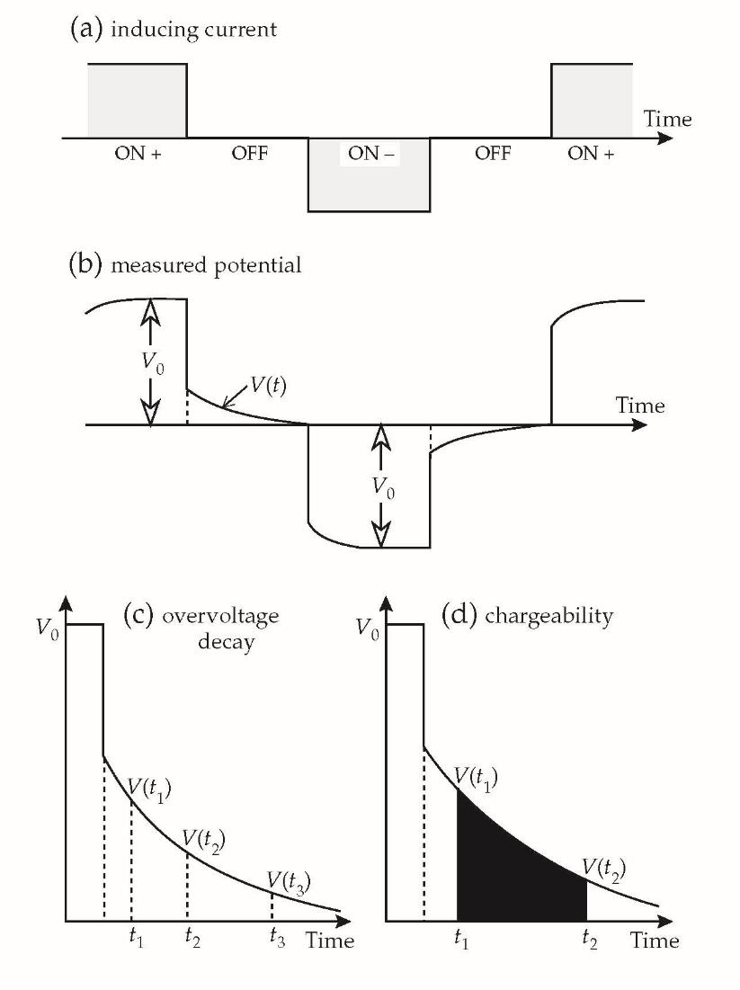
Another Geophysical Method Induced Polarization
Resistivity – electrical resistance to current flow
Induced Polarization – capacitance and inductance

Slide 31
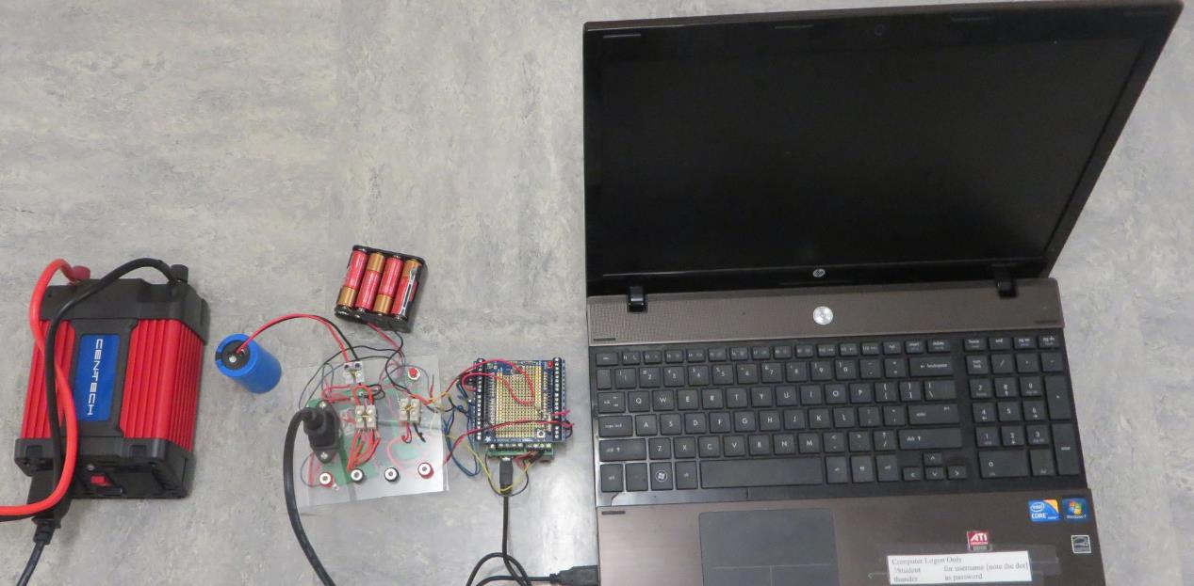
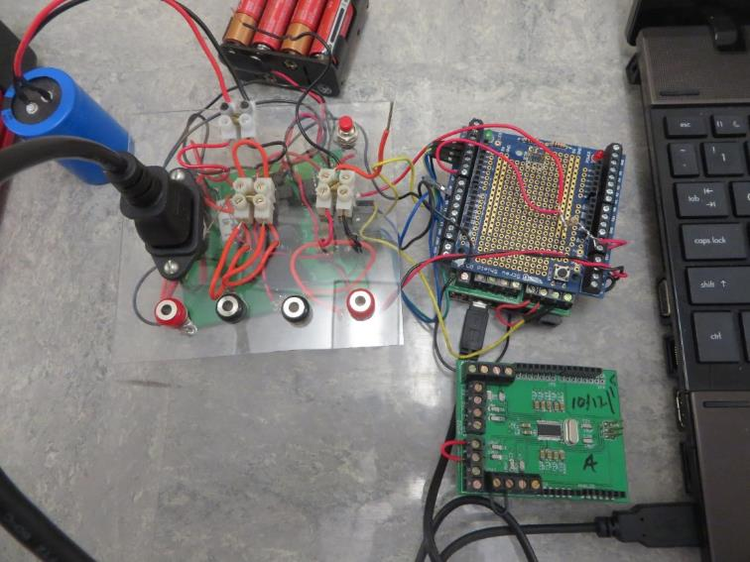
Micro-computer Resistivity/Induced Polarization Instrument
24-bit Analog/Digital Converter
Automatic current reversing
20 readings/second
Cost < $70

Slide 32
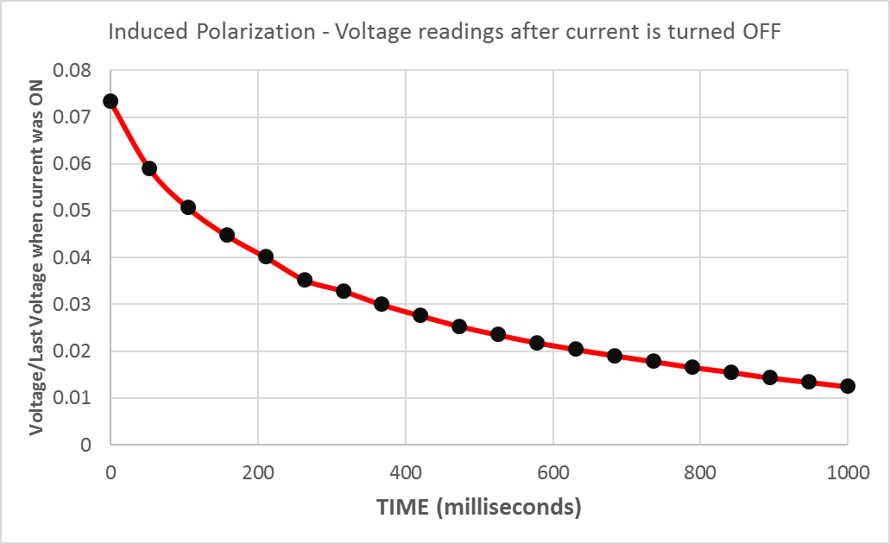

Slide 33
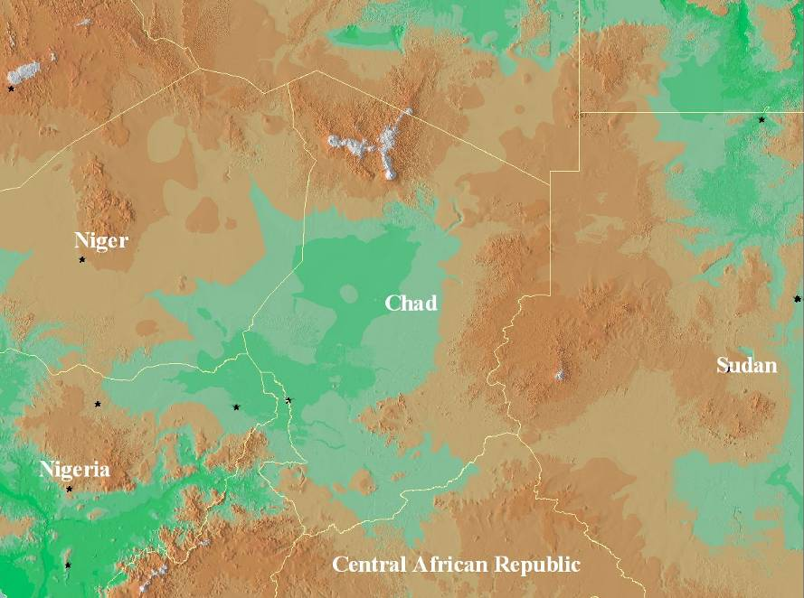
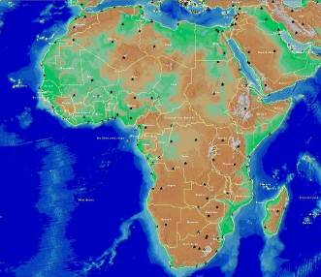
CHAD
Abeche
Moundou

Slide 34
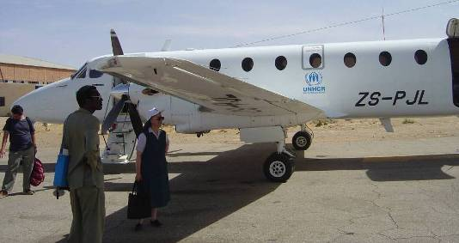

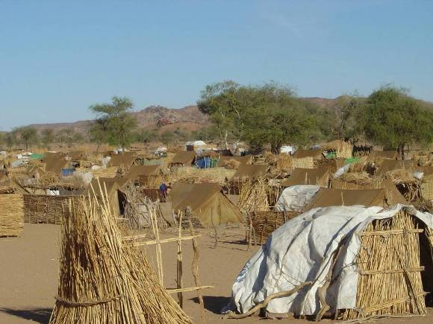
Aircraft - UN High Commission for Refugees - UNHCR
Treguine Camp
14,000 residents
United Nations camp in Eastern Chad for Sudanese Refugees

Slide 35
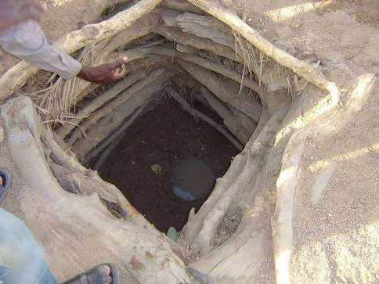
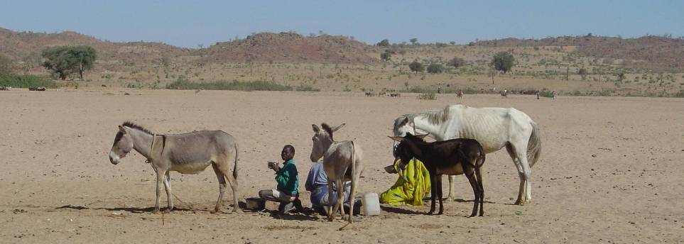
Faguire Dry Well
Children collecting water from dry river bed 2 km from village

Slide 36
Chad Hydrologic Stratigraphy
No water during the 6-month dry season
Wells in arroyos (wadis) of sand and gravel overlying granite bedrock
Well depth limited by bedrock
Bedrock contact highly irregular
Sand and Gravel
Wet Season
Granite
Dry Season

Slide 37
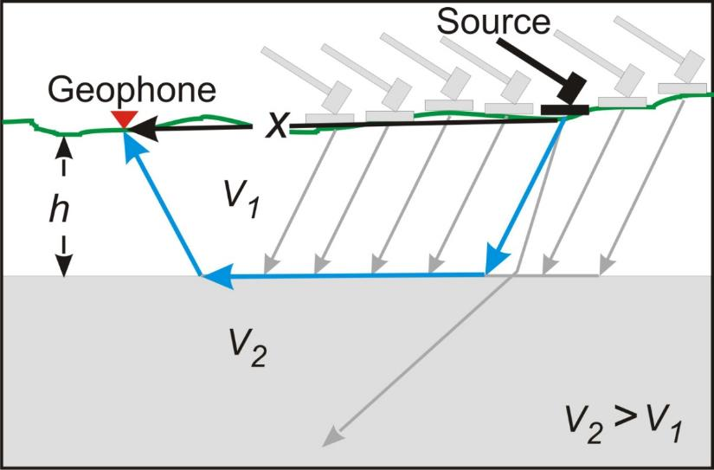
Seismic Refraction Method
Source
Geophones
Usual method
Seismic source (sledge)
Seismic shockwave recorded at 12 geophones
Time of wave arrival → depth to refracting surface
A
V
1
Z
B
B
B
V
2
Our method
Seismic source (sledge) moved repeatedly
Seismic shockwave recorded at a single geophone
Exactly analogous to traditional method

Slide 38
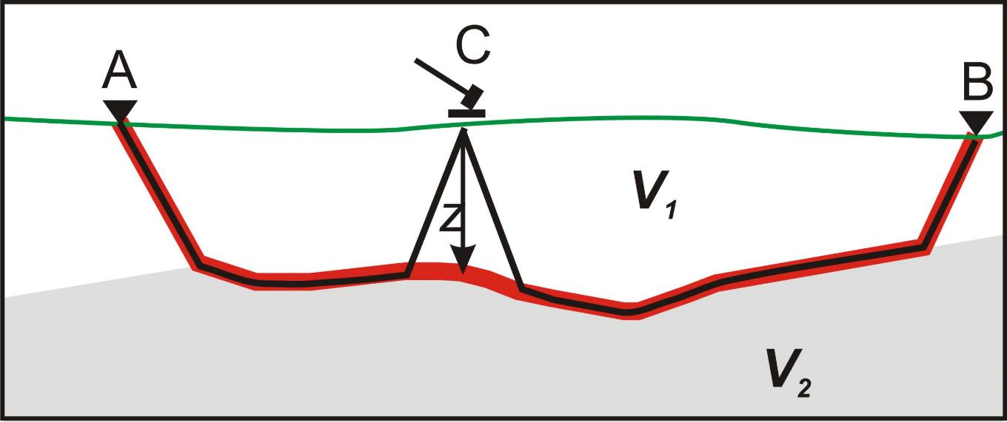
Delay-Time Seismic Refraction Method
Determines depth to refracting layer
Interface can be undulating

Slide 39
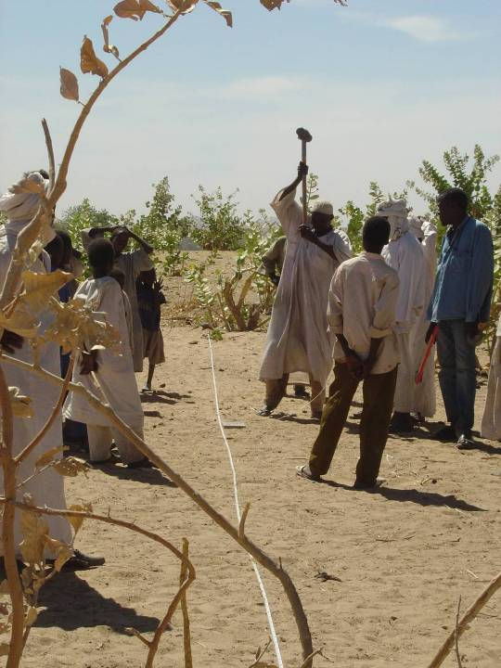
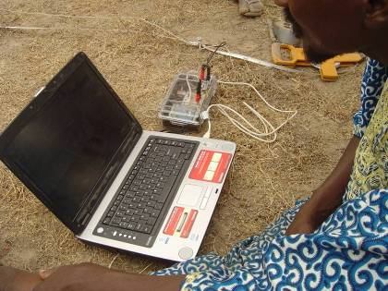
Field Procedure
←“Seismic Source”
Field Instrumentation

Slide 40
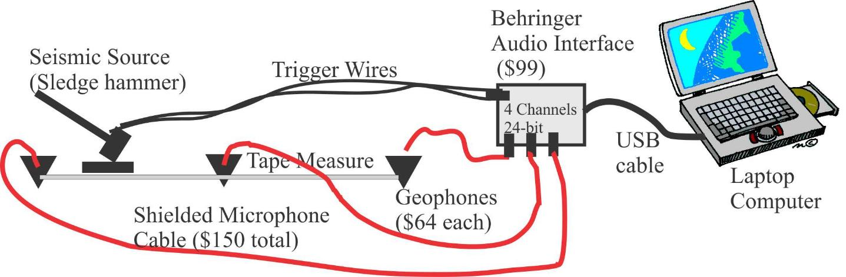
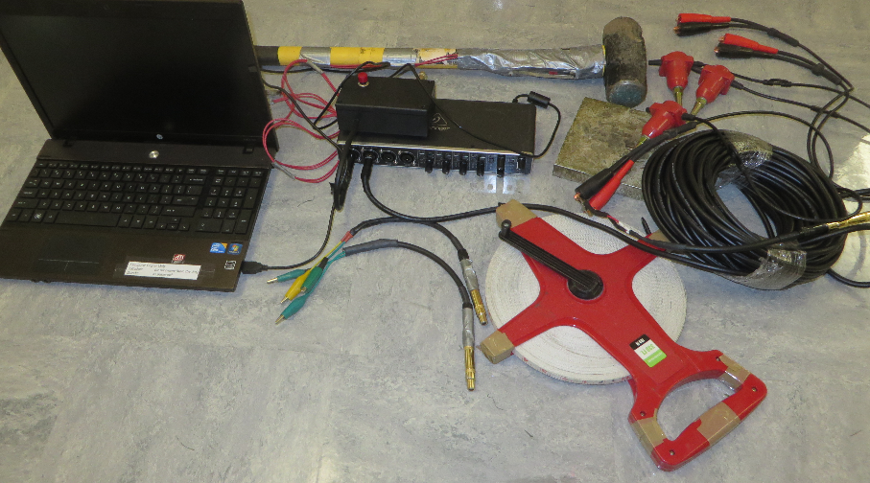
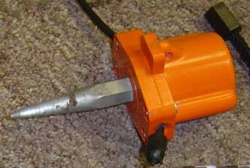
Schematic of Field Setup

Slide 41
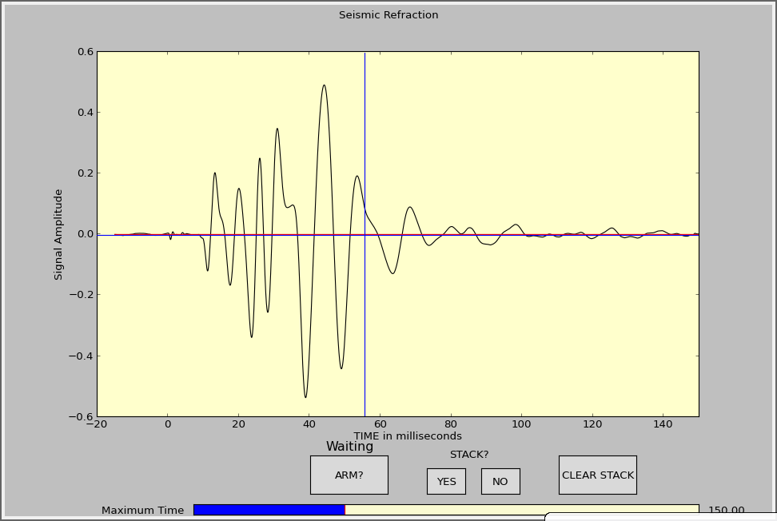
PYTHON Program
Pre-
Trigger

Slide 42
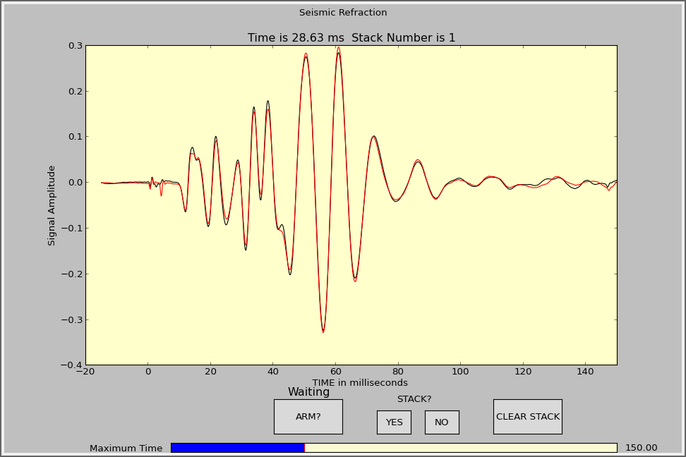
Stacked Signal

Slide 43

First Break Pick – signal enlarged

Slide 44

My WindowsSIPTwater Program

Slide 45


Slide 46

Travel-Time Data

Slide 47

Geologic Section

Slide 48
Delay-Time Method Subsurface Profile
Seismic Line Distance (m)
Location of Faguire Hand-Dug Well

Slide 49



Tel Shimron Israel Archaeology Site

Slide 50


Another Geophysical Method Seismo-electric
Seismic shock wave excites H2O molecules resulting in an electromagnetic signal traveling at speed of light
Software developed to remove electromagnetic noise
Subtracts 2 antenna results
Removes periodic (50 Hz plus overtones)
GEOPHONE
Time (ms)
SEISMOELECTRIC

Slide 51

Another Geophysical Method Surface Waves
Seismic Body Waves:
Refraction and reflection
Surface waves: Rayleigh and Love
Large signal
Velocity inversion OK
Depth is about distance to farthest geophone/2

Slide 52





Surface Wave Analysis
Fourier Spectrum
Phase angle shift
2 waves
Phase uncertainty
Cross-power comparison

Slide 53

Journal of Water Resource and Protection – Free Open Access Online Journal – 5 years ago
Not prestigious (i.e. you won’t get tenure publishing here) but useful
“Peer reviewed” – but not selective
9,671 downloads 17,327 views

Slide 54
Conclusions
Geophysics can help find depth to bedrock in support of well drilling projects
Resistivity and seismic instruments can be constructed cheaply from readily available parts
Our free software and data can improve interpretation of the geophysics
Complete suite of geophysical tools can be assembled for less than $700. [resistivity, induced polarization, seismic refraction, seismoelectric, surface wave analysis]
Inexpensive devices can be left with trained indigenous well drillers to aid in locating well sites

Slide 55
Acknowledgements
Wheaton College Alumni Association
Timothy Project
LifeWater International
EEMET (Entente des Eglises Et Missions Evangeliques au Tchad)
United Nations High Commission for Refugees

